Slide 1
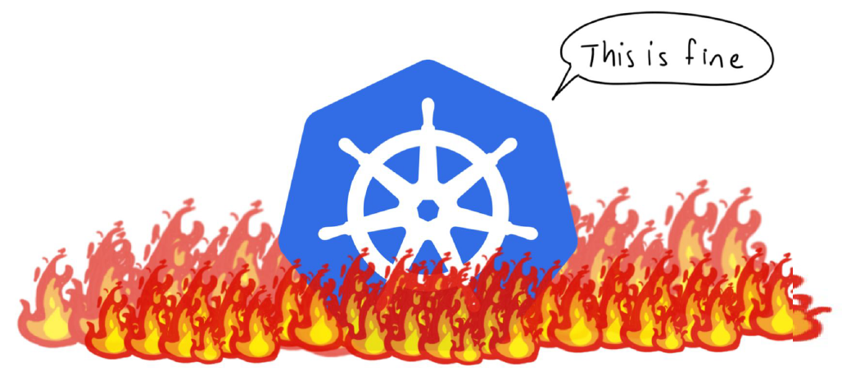
Kubernetes – Several Aspects
Krzysztof Pudłowski - Online

Slide 2
History of Kubernetes
According to the Kubernetes website,
"Kubernetes is an open-source system for automating deployment, scaling, and management of containerized applications."
Kubernetes comes from the Greek word κυβερνήτης, which means helmsman or ship pilot. With this analogy in mind, we can think of Kubernetes as the pilot on a ship of containers.
Kubernetes is also referred to as k8s, as there are 8 characters between k and s.
Kubernetes is highly inspired by the Google Borg system, a container orchestrator for its global operations for more than a decade. It is an open source project written in the Go language and licensed under the Apache License, Version 2.0.
Kubernetes was started by Google and, with its v1.0 release in July 2015, Google donated it to the Cloud Native Computing Foundation (CNCF).
New Kubernetes versions are released in 3 months cycles. The current stable version is 1.18 (as of June 2020).

Slide 3
Kubernetes features
Kubernetes offers a very rich set of features for container orchestration. Some of its fully supported features are:
Automatic binpacking Kubernetes automatically schedules the containers based on resource usage and constraints, without sacrificing the availability.
Self-healing Kubernetes automatically replaces and reschedules the containers from failed nodes. It also kills and restarts the containers which do not respond to health checks, based on existing rules/policy.
Horizontal scaling Kubernetes can automatically scale applications based on resource usage like CPU and memory. In some cases, it also supports dynamic scaling based on customer metrics.
Service discovery and Load balancing Kubernetes groups sets of containers and refers to them via a DNS name. This DNS name is also called a Kubernetes service. Kubernetes can discover these services automatically, and load-balance requests between containers of a given service.
https://sites.google.com/site/edxkubernetes/home

Slide 4
Kubernetes features
Automated rollouts and rollbacks Kubernetes can roll out and roll back new versions/configurations of an application, without introducing any downtime.
Secrets and configuration management Kubernetes can manage secrets and configuration details for an application without re-building the respective images. With secrets, we can share confidential information to our application without exposing it to the stack configuration, like on GitHub.
Storage orchestration With Kubernetes and its plugins, we can automatically mount local, external, and storage solutions to the containers in a seamless manner, based on Software Defined Storage (SDS).
Batch execution Besides long running jobs, Kubernetes also supports batch execution.

Slide 5
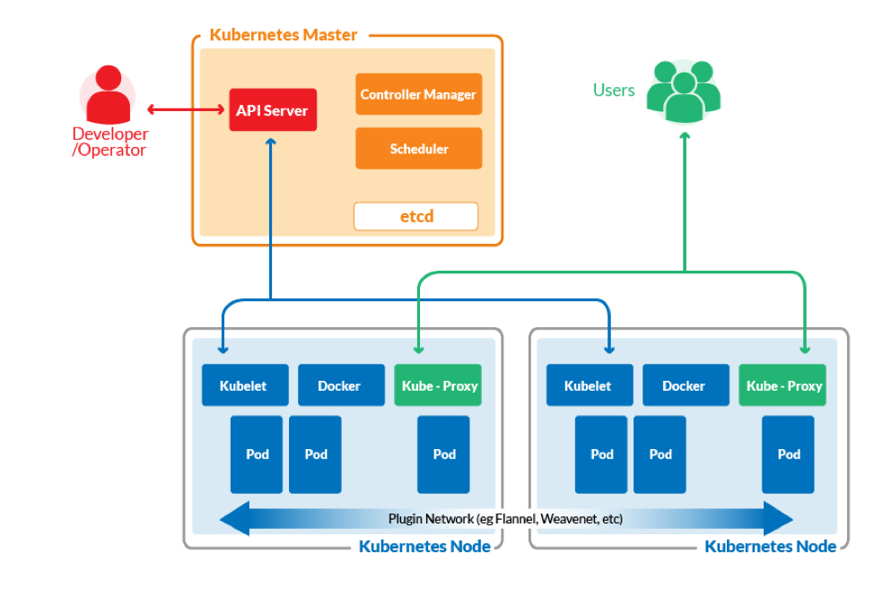
ArchiteCture of k8s Cluster

Slide 6
Limits of THAT SOLUTION
At v1.18, Kubernetes supports clusters with up to 5000 nodes. More specifically, we support configurations that meet all of the following criteria:
No more than 5000 nodes
No more than 150000 total pods
No more than 300000 total containers
No more than 100 pods per node
https://kubernetes.io/docs/setup/best-practices/cluster-large/

Slide 7
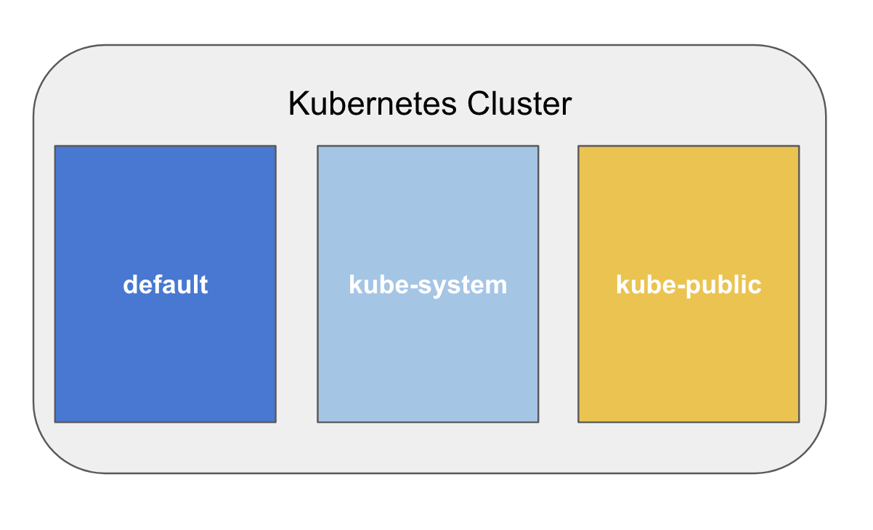
NamespaceS
Beyond the individual container resources, you may want to investigate setting limits on namespaces. So what is a namespace?
Namespaces can be used to define a cluster of applications, departments, or environments. Simply, Namespace refers to scope or grouping of objects in a Kubernetes cluster
kind: Namespace
apiVersion: v1
metadata:

Slide 8
INTERNAL DNS
The Domain Name System (DNS) is a system for associating various types of information – such as IP addresses – with easy-to-remember names. By default most Kubernetes clusters automatically configure an internal DNS service to provide a lightweight mechanism for service discovery. Built-in service discovery makes it easier for applications to find and communicate with each other on Kubernetes clusters, even when pods and services are being created, deleted, and shifted between nodes.
pod-name.namespace.cluster.local
service-name.svc.namespace.cluster.local

Slide 9
BASIC OBJECTS
Pod
ReplicaSet
Deployment
HPA
Service
Ingress

Slide 10
Kubernetes- Resource Configs
Resource Configs
Each entity created with kubernetes is a resource including pod, service, deployments, replication controller etc.
Resources can be defined as YAML or JSON.
Here is the gerenal syntax to create a YAML specification.
AKMS => Resource Configs Specs
apiVersion: v1
kind:
metadata:
…
spec:
…
kubectl api-versions

Slide 11
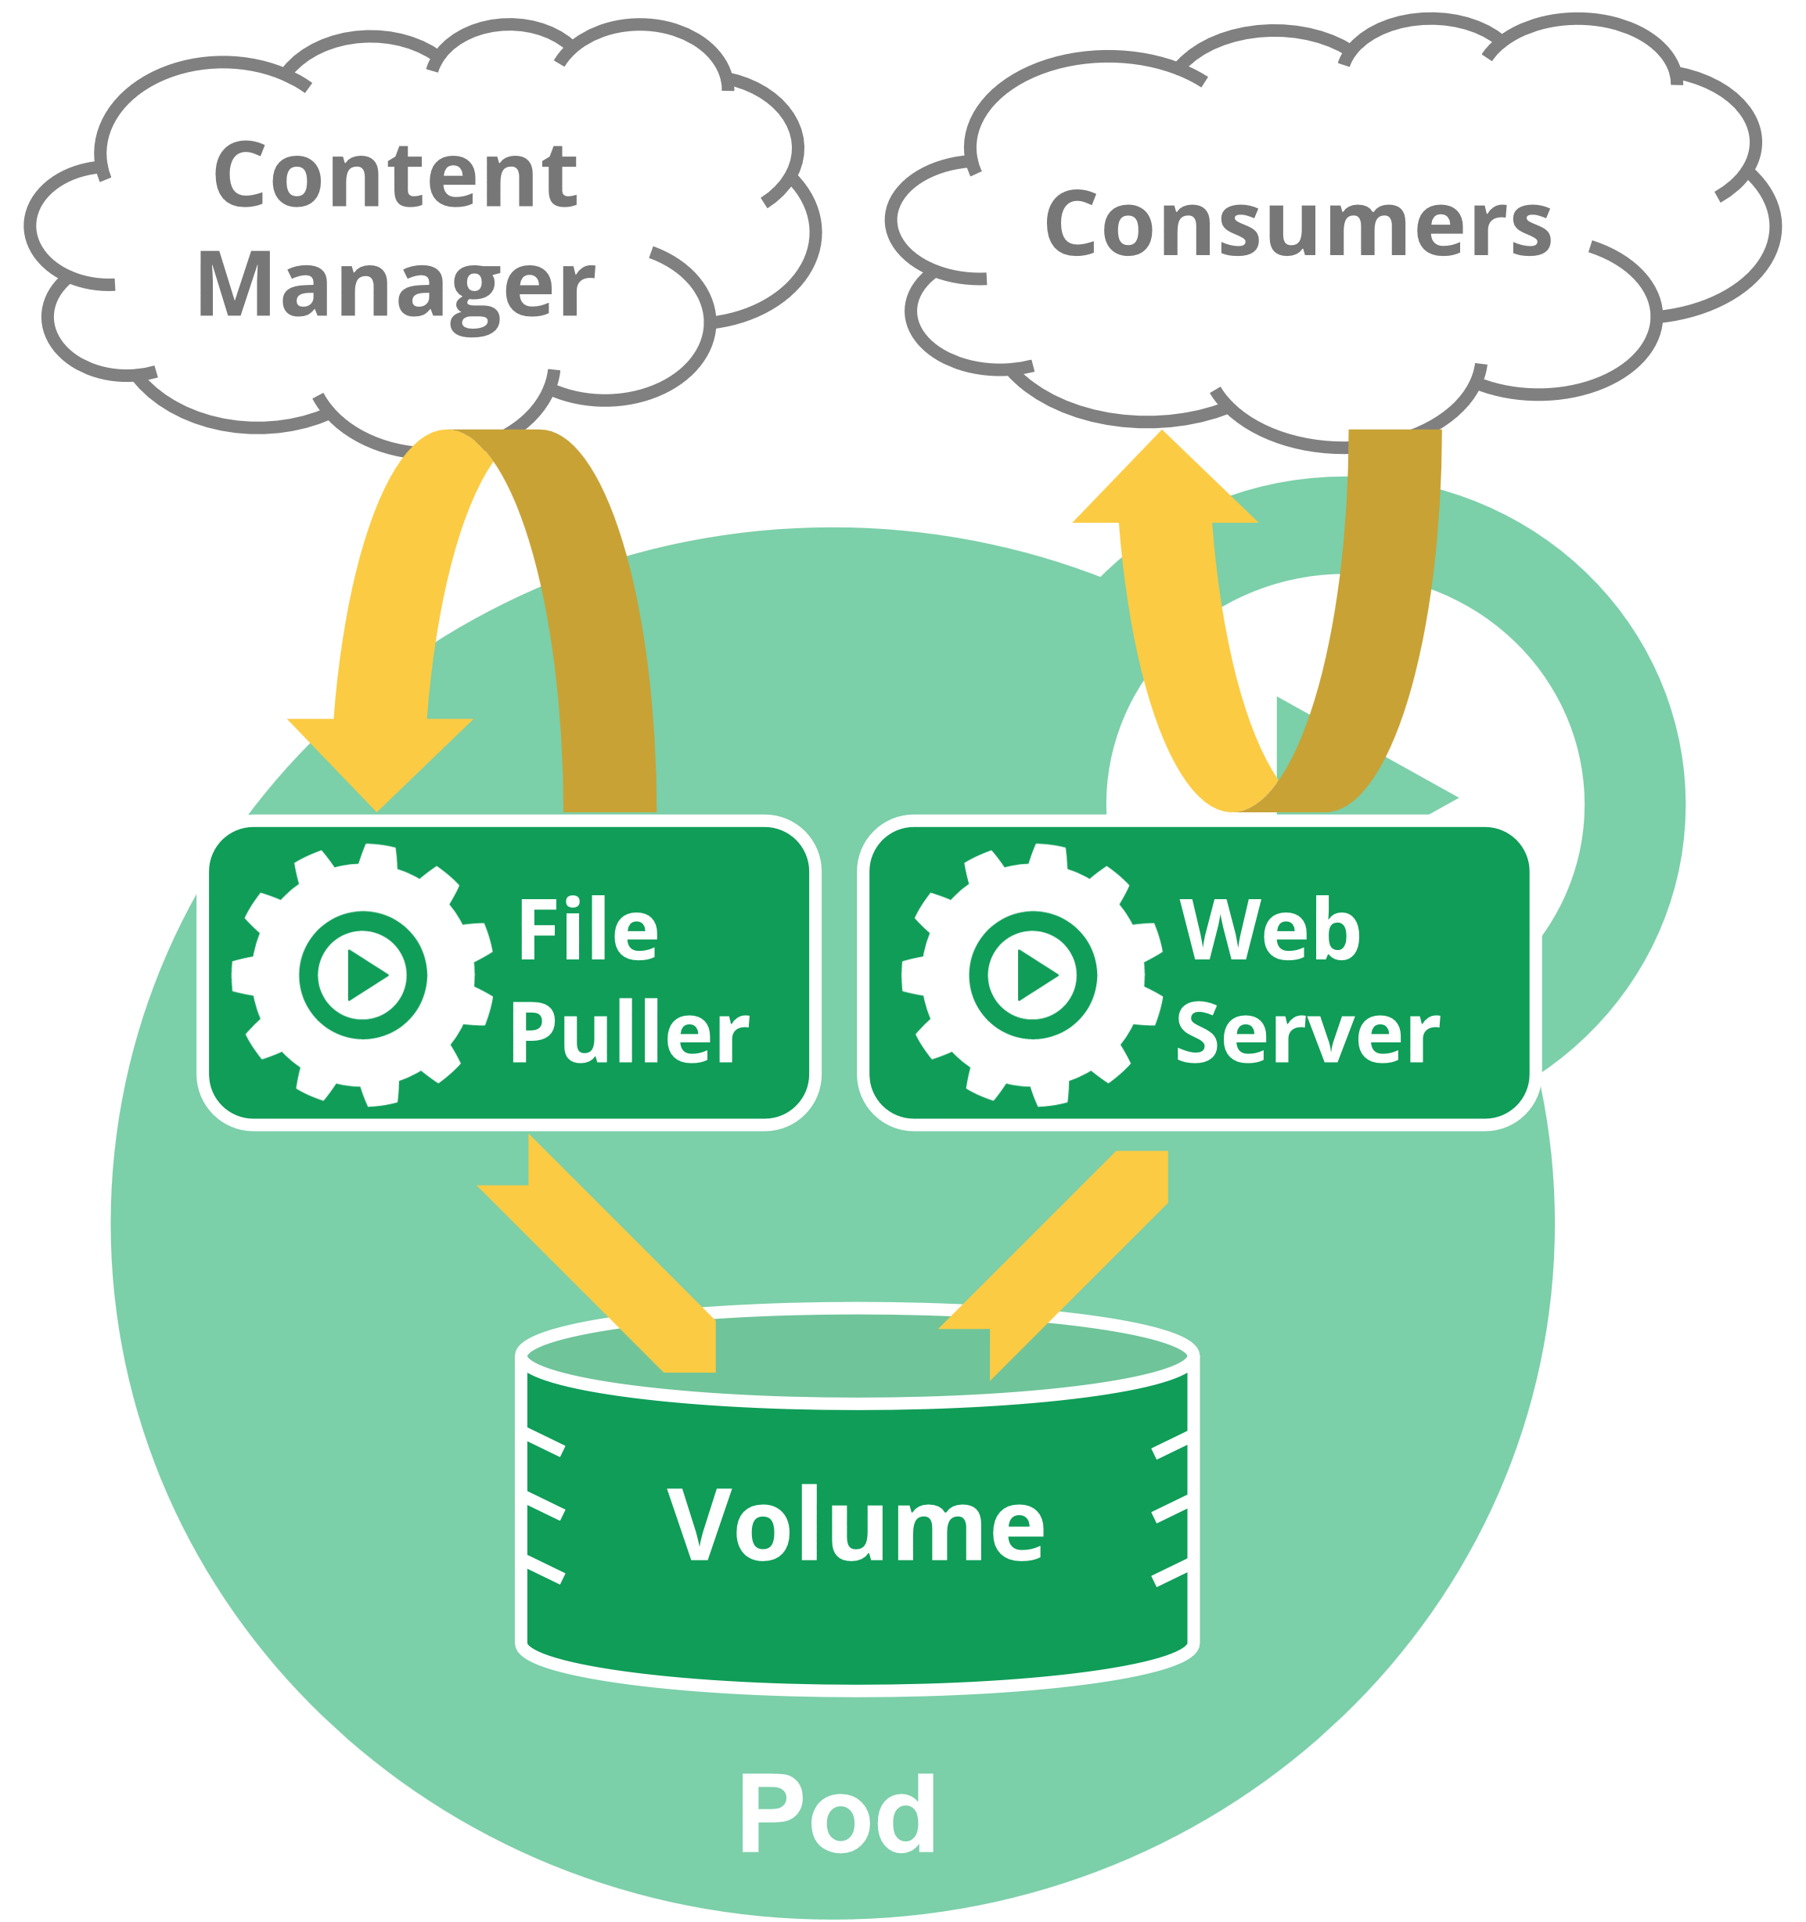
Kubernetes POD
apiVersion: v1
kind: Pod
metadata:
spec:
A Kubernetes pod is a group of containers that are deployed together on the same host

Slide 12
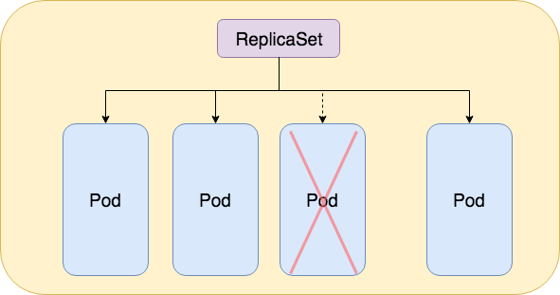
Kubernetes ReplicaSET
apiVersion: apps/v1
kind: ReplicaSet
metadata:
spec:
https://www.magalix.com/blog/kubernetes-replicaset-101

Slide 13
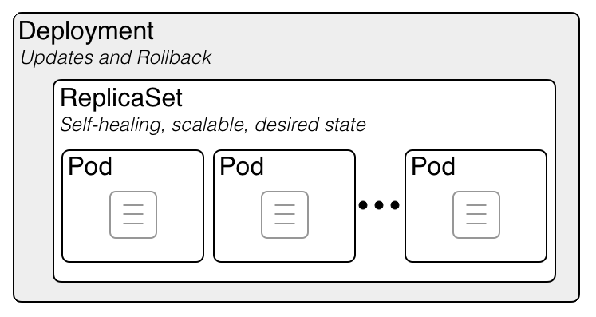
KUBERNETES DEPLOYMENT
apiVersion: apps/v1
kind: Deployment
metadata:
spec:

Slide 14
Kuberneres pOD
DEMO

Slide 15
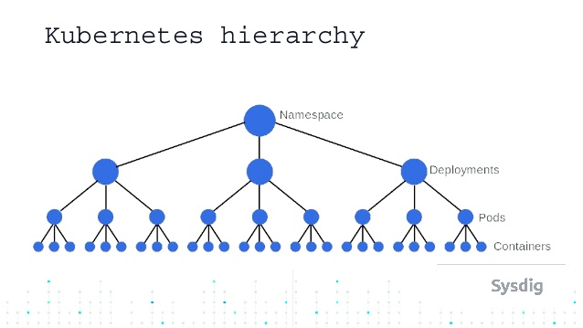
Objects hierarchy so far

Slide 16
Network model
Every Pod gets its own IP address.
This means you do not need to explicitly create links between Pods and you almost never need to deal with mapping container ports to host ports. This creates a clean, backwards-compatible model where Pods can be treated much like VMs or physical hosts from the perspectives of port allocation, naming, service discovery, load balancing, application configuration, and migration. Kubernetes imposes the following fundamental requirements on any networking implementation (barring any intentional network segmentation policies):
pods on a node can communicate with all pods on all nodes without NAT
agents on a node (e.g. system daemons, kubelet) can communicate with all pods on that node
Note: For those platforms that support Pods running in the host network (e.g. Linux):
pods in the host network of a node can communicate with all pods on all nodes without NAT

Slide 17
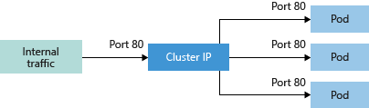
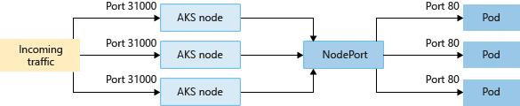
KUBERNETES SERVICE
Cluster IP - Creates an internal IP address for use within the k8s cluster. Good for internal-only applications that support other workloads within the cluster.
NodePort - Creates a port mapping on the underlying node that allows the application to be accessed directly with the node IP address and port.

Slide 18
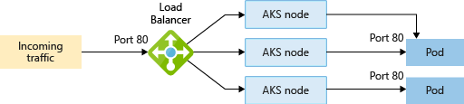
KUBERNETES SERVICE
LoadBalancer - Creates an Azure load balancer resource, configures an external IP address, and connects the requested pods to the load balancer backend pool. To allow customers' traffic to reach the application, load balancing rules are created on the desired ports.

Slide 19
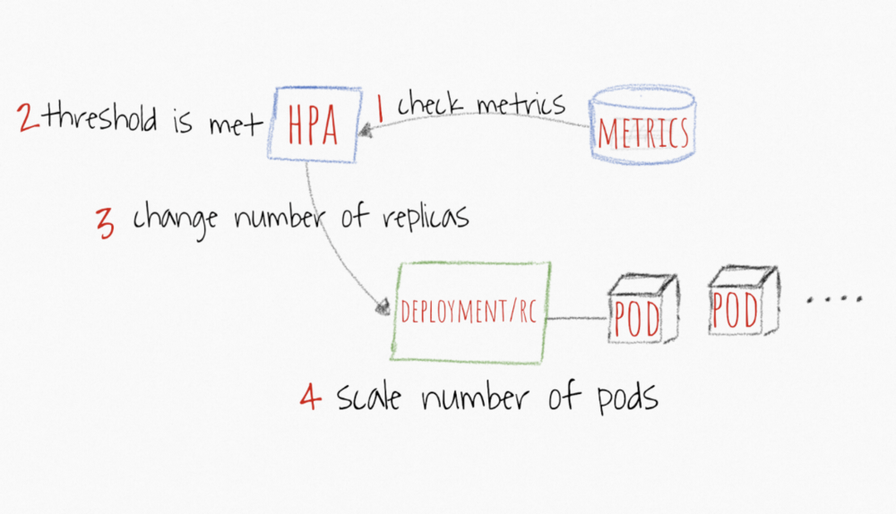
Horizontal pod autoscaler (HPA)
HPA continuously checks metrics values you configure during setup AT A DEFAULT 30 SEC intervals
HPA attempts to increase the number of pods If the SPECIFIED threshold is met
https://www.magalix.com/blog/kubernetes-autoscaling-101

Slide 20
KUBERNETES HPA
apiVersion: autoscaling/v1
kind: HorizontalPodAutoscaler
metadata:
spec:
From the most basic perspective,
the Horizontal Pod Autoscaler controller operates on the ratio
between desired metric value and current metric value:
desiredReplicas = ceil[currentReplicas * ( currentMetricValue / desiredMetricValue )]
spec:
minReplicas: 4
maxReplicas: 15
targetCPUUtilizationPercentage: 40
scaleTargetRef:
apiVersion: apps/v1
kind: Deployment
name: vote

Slide 21
KUBERNETES HPA,SERVICES
DEMO

Slide 22
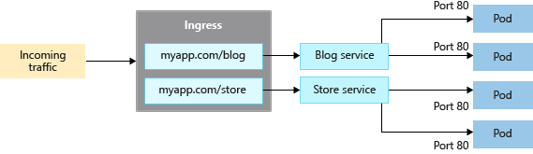
Kubernetes INGRESS
There are two components for ingress:
An ingress resource, and
An ingress controller

Slide 23
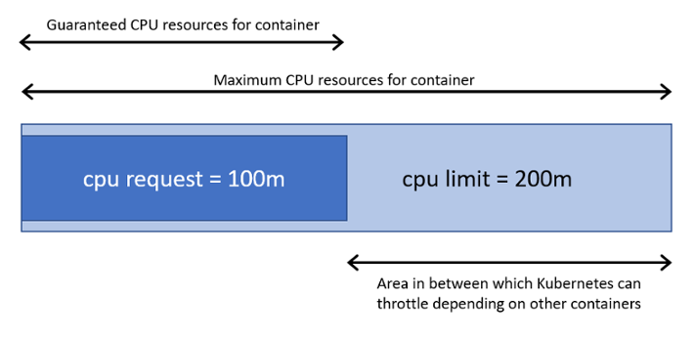
Using resources
Requests, Limits
In Kubernetes, there are two types of resources: CPU and Memory. CPU is measured in core units, and memory is specified in bytes.
At the Namespace level, you can set up ResourceQuotas and LimitRanges.

Slide 24
Resource Quota
apiVersion: v1
kind: ResourceQuota
metadata:
name: compute-resources
spec:
hard:
pods: "20"
requests.cpu: "1"
requests.memory: 1Gi
limits.cpu: "2"
limits.memory: 2Gi
requests.nvidia.com/gpu: 3

Slide 25
Limit Range
apiVersion: v1
kind: LimitRange
metadata:
name: limit-mem-cpu-per-container
spec:
limits:
- max:
cpu: "800m"
memory: "1Gi"
min:
cpu: "50m"
memory: "50Mi"
type: Container
default:
cpu: "200m"
memory: "200Mi"
defaultRequest:
cpu: "100m"
memory: "100Mi"

Slide 26
KUBERNETES SECURITY
RBAC
Network Policy
Pod Security Policy
Cluster Audit

Slide 27
Model RBAC
The connection between user and resources is defined in RBAC using two objects.
Roles A Role is a collection of permissions. For example, a role could be defined to include read permission on pods and list permission for pods.
Role Bindings A RoleBinding maps a Role to a user or set of users, granting that Role’s permissions to those users for resources in that namespace.
ClusterRole
A ClusterRole is just like a Role, but can be used anywhere in the cluster.
ClusterRoleBinding
A ClusterRoleBinding allows users to be granted a ClusterRole for authorization across the entire cluster.

Slide 28
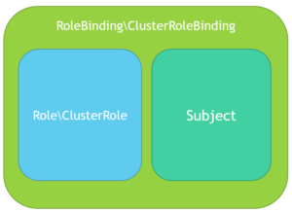
MODEl RBAC
Role\ClusterRole ­– The actual permission. It contains rules that represent a set of permissions. Each rule contains resources and verbs. The verb is the action that will apply on the resource.
Subject (User, Group or ServiceAccount) – The object that will receive the permissions.
RoleBinding\ClusterRoleBinding – The connection between Role\ClusterRole and the subject.

Slide 29
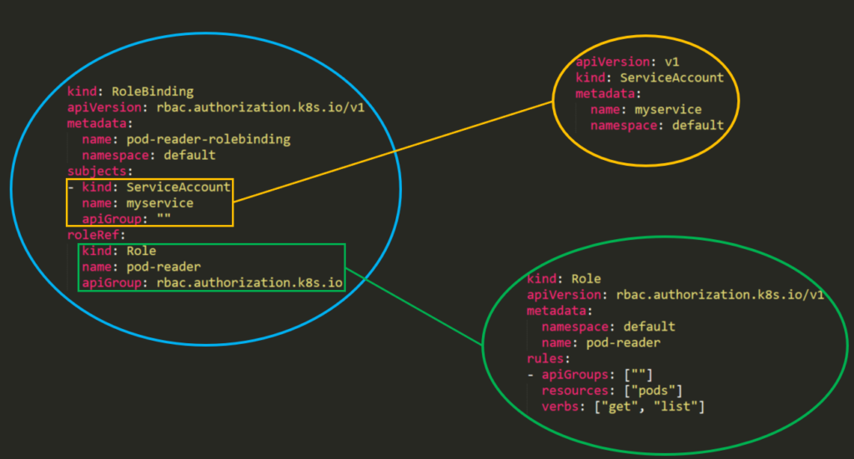
Model RBAC

Slide 30
NETWORK POLICY
Network policies are implemented by the network plugin. To use network policies, you must be using a networking solution which supports NetworkPolicy. Creating a NetworkPolicy resource without a controller that implements it will have no effect.
Isolated and Non-isolated Pods
By default, pods are non-isolated; they accept traffic from any source.
Pods become isolated by having a NetworkPolicy that selects them. Once there is any NetworkPolicy in a namespace selecting a particular pod, that pod will reject any connections that are not allowed by any NetworkPolicy. (Other pods in the namespace that are not selected by any NetworkPolicy will continue to accept all traffic.)

Slide 31
Pod security Policy
Pod Security Policies are cluster-wide resources that control security sensitive aspects of pod specification. PSP objects define a set of conditions that a pod must run with in order to be accepted into the system, as well as defaults for their related fields. PodSecurityPolicy is an optional admission controller that is enabled by default through the API, thus policies can be deployed without the PSP admission plugin enabled. This functions as a validating and mutating controller simultaneously.

Slide 32
PoD SECURITY POLICY
Example of a restricted PodSecurityPolicy used cluster-wide
runAsUser: 1000 means all containers in the pod will run as user UID 1000
fsGroup: 2000 means the owner for mounted volumes and any files created in that volume will be GID 2000
allowPrivilegeEscalation: false means the container cannot escalate privileges
readOnlyRootFilesystem: true means the container can only read the root filesystem
https://docs.microsoft.com/en-us/azure/aks/use-pod-security-policies
https://docs.microsoft.com/en-us/azure/aks/use-pod-security-policies
https://banzaicloud.com/blog/pod-security-policy/

Slide 33
Kubernetes Cluster AUDIT
https://github.com/aquasecurity/kube-bench
kubectl apply –f https://raw.githubusercontent.com/aquasecurity/kube-bench/master/job.yaml \
-n default
kubectl logs kube-bench-jsnck -n default
https://github.com/cyberark/kubernetes-rbac-audit

Slide 34

Q&A

